Slide 1

DEPARTMENT OF COMPUTER SCIENCE & ENGINEERING
SCHOOL OF COMPUTING
10214CS601 MINOR PROJECT -1
SUMMER SEMESTER(2025-2026)
SEMESTER END PROJECT VIVA VOCE EXAMINATIONS
“BONE FACTURE DETECTION SYSTEM USING YOLO DEEP LEARNING”
SUPERVISED BY
PRESENTED BY
Dr.N.R.RajaLakshmi
Professor
V.SAI NAVADEEP KRISHNA (VTU 24596)(23UECS0600)
P.HARSHA VARDHAN (VTU 24747)(23UECS0433)
3. B.YASHWANTH (VTU 24565)(23UECS0076)

Slide 2
OVERVIEW
  ABSTRACT
  OBJECTIVE
  INTRODUCTION
  LITERATURE REVIEW (SOFT COPY OF PAPERS TO BE LINKED AS HYPERLINK)
  DESIGN AND METHODOLOGIES
  IMPLEMENTATION
  TESTING
  INPUT AND OUTPUT
  INCLUDE DEMO VIDEO-1 (Till REVEW-1)
  INCLUDE DEMO VIDEO-2(Complete Implementation of Project)
  CONCLUSION
  WEB REFERENCES LINK (TILL REVIEW DATE ALL LINKS TO BE INCLUDED DAY WISE)
  PLAGIARISM REPORT OF PPT
  REFERENCES

Slide 3
  ABSTRACT
  Introduction:
  Bone fractures are one of the most common medical issues that require quick and accurate diagnosis. Traditional fracture detection relies on doctors manually examining X-ray images, which can be time-consuming. This project introduces an AI-based approach to assist in faster and more reliable fracture identification.
  Purpose:
  The main goal of this project is to design an intelligent healthcare system that can automatically detect bone fractures from X-ray images. It also aims to provide a secure web platform for patients to upload X-rays and share results with doctors for further analysis.
  Method:
  The system is built using Python and Django, integrating the YOLO (You Only Look Once) deep learning algorithm for real-time fracture detection. Uploaded X-ray images are processed, analyzed, and stored in a MySQL database with encrypted user details. The web interface allows patients and doctors to interact easily and manage reports efficiently.
  Result:
  The developed system successfully detects fractures, identifies their type and severity, and highlights the affected area with bounding boxes. It offers a user-friendly interface for both patients and doctors, improving the accessibility and speed of medical diagnosis.
  Conclusion:
  This project demonstrates how deep learning can effectively support healthcare by providing fast and accurate fracture detection. It ensures secure data handling and better communication between patients and doctors, promoting the use of AI in smart medical diagnosis.

Slide 4
  OBJECTIVES
Aim of the Project
Develop Deep Learning Detection: Create a system to automatically detect bone fractures from X-ray images, accelerating the initial diagnostic screening process, particularly in critical Emergency Room settings.
Utilize YOLO for Localization: Employ the YOLO deep learning algorithm for accurate and real-time object detection, crucial for quickly localizing fractures and indicating severity using bounding boxes.
Build Secure Web Platform: Construct a reliable, secure web platform to connect patients and doctors, establishing an efficient digital pipeline for medical records and improving patient-doctor interaction.
2. Scope of the Project
Secure Patient Data Control: Patients securely upload X-rays and share them by explicitly selecting a doctor to grant viewing permission, maintaining absolute control over their medical data.
Clinical Diagnostic Assistance: The system analyzes X-ray images to identify the type and severity of bone fractures. Authorized doctors review the AI-assisted reports to provide final prescriptions or suggestions.
Mandatory Data Security: Data privacy is ensured through password encryption for all users (doctor and patient), storing credentials in encrypted formats to ensure a safe medical environment.

Slide 5
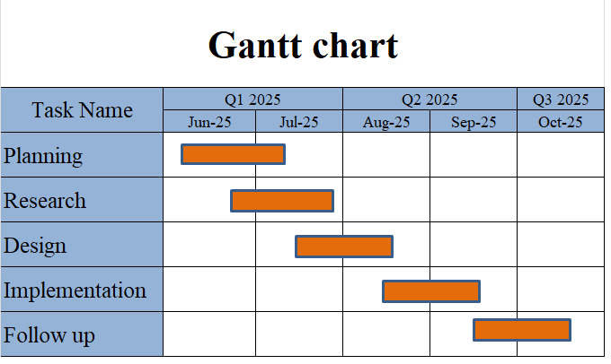
TIMELINE OF THE PROJECT

Slide 6
  INTRODUCTION
Bone fractures occur frequently due to accidents, sports injuries, and age-related bone problems, making fracture diagnosis a crucial medical procedure worldwide.
Manual examination of X-ray images requires expert skills and can sometimes lead to delays in treatment, especially in rural or emergency conditions where specialists are not immediately available.
Artificial Intelligence and Deep Learning have shown significant improvements in automating medical image analysis by detecting visual patterns that may be difficult to identify quickly with the human eye.
YOLO (You Only Look Once), a fast and highly accurate object detection algorithm, is well-suited for real-time medical assistance by detecting and highlighting fracture regions in X-ray images.
This project integrates the YOLO model into a secure web platform, enabling patients to upload their X-rays and doctors to access AI-generated reports from anywhere at any time.
The system not only detects the presence of fractures but also provides details like fracture location and severity, helping doctors make better and quicker decisions.
By combining modern AI technology and digital healthcare services, the project improves diagnosis efficiency, accessibility, data security, and patient–doctor communication.

Slide 7
  LITERATURE REVIEW
Sl.No | Author’s Name | Paper name and publication details | Year of publication | Main content of the paper
1 | A. Kutbi, A. Al-Saggaf, and A. M. Al-Ahmadi | “Artificial intelligence-based applications for bone fracture detection: A systematic review,” Healthcare, vol. 12, no. 3, pp. 309–325,2024 | 2024 | A survey of existing fracture detection methods, which helped to identify the current gaps in solutions that this project aims to address.
2 | L. Su, Y. Wang, and H. Chen | “Skeletal fracture detection with deep learning: A comprehensive review,” Frontiers in Radiology, vol. 2, pp. 112–128, 2023 | 2023 | A comprehensive overview covering existing deep learning approaches for skeletal fracture detection and detailing the challenges faced by these models.
3 | ] X. Ju et al | “Fracture detection in paediatric wrist trauma X-ray images using YOLOv8,” Scientific Reports, vol. 13, no. 12567, pp. 1–12, 2023 | 2023 | Directly supports the chosen approach, demonstrating that YOLOv8 is effective for fracture detection in X-ray images, specifically in pediatric wrist trauma.

Slide 8
4 | P. Rajpurkar et al | “MURA: Large dataset for abnormality detection in musculoskeletal radiographs,” arXiv preprint arXiv:1712.06957, 2022. | 2022 | Describes the MURA dataset, an important and large dataset widely used for abnormality detection in musculoskeletal radiographs, which is foundational for many existing fracture detection systems.
5 | ] Z. Wu et al | “YOLOv9: Improved real-time object detection with enhanced feature learning,” arXiv preprint arXiv:2402.13616, 2024. | 2024 | Presents the latest YOLO variant, supporting the decision to use YOLO-based methods for improved real-time object detection and enhanced feature learning

Slide 9
  DESIGN AND METHODOLOGIES
  MODULE 1
  Data Collection of X-ray Images:
  The project relies on a large collection of X-ray images that are essential for training the deep learning model.
  Dataset Source: MURA (Musculoskeletal Radiographs) or a similar large-scale X-ray image collection is used to provide clinical relevance and diversity in fracture types.
  Initial Structure: The raw data is hierarchically organized, with studies labeled as ..._positive (fractured/abnormal) and ..._negative (normal), with duplicate image names across patient folders.
  MODULE 2
  Patient Interface:
  X-ray Upload: Allows patients to securely upload their X-ray images to the system.
  Doctor Permission Grant: Patients explicitly select a doctor to grant viewing permission to their X-ray report and results, maintaining data control.
  History Viewing: Enables patients to view a record of their past uploaded X-rays and detection reports.
  Secure Record Management: Provides an interface for patients to securely manage their sensitive medical records.

Slide 10
  DESIGN AND METHODOLOGIES
MODULE 3
Fracture Detection Engine:
YOLO Algorithm Application: The YOLO deep learning algorithm is applied on the uploaded X-ray image for analysis.
Fracture Localization: The system identifies and visually outlines the fracture location using bounding boxes.
Classification & Severity: The model detects the type of fracture and shows its severity.
Detection Result Storage: The fracture detection results, including type and severity, are saved directly into the MySQL database.
MODULE 4
Doctor Interface & Clinical Review:
Secure Access to Reports: Doctors log in and can only access the X-ray reports for which the patient has granted permission.
Review AI Results: Doctors view the X-ray image alongside the AI's detection results (bounding boxes, fracture type).
Clinical Suggestions: Based on the AI-assisted report, the doctor can provide medical suggestions or prescriptions.
Efficient Interaction: The system streamlines the patient-doctor interaction and contributes to efficient medical record management.

Slide 11
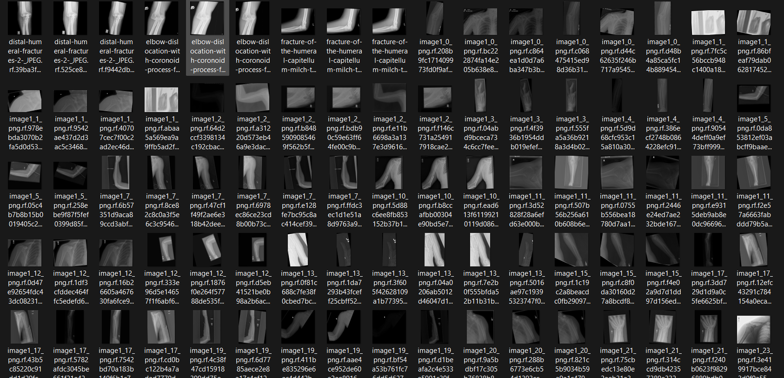
MODULE 1:
Data Collection of X-ray Images:
Step:1 Collection of data

Slide 12
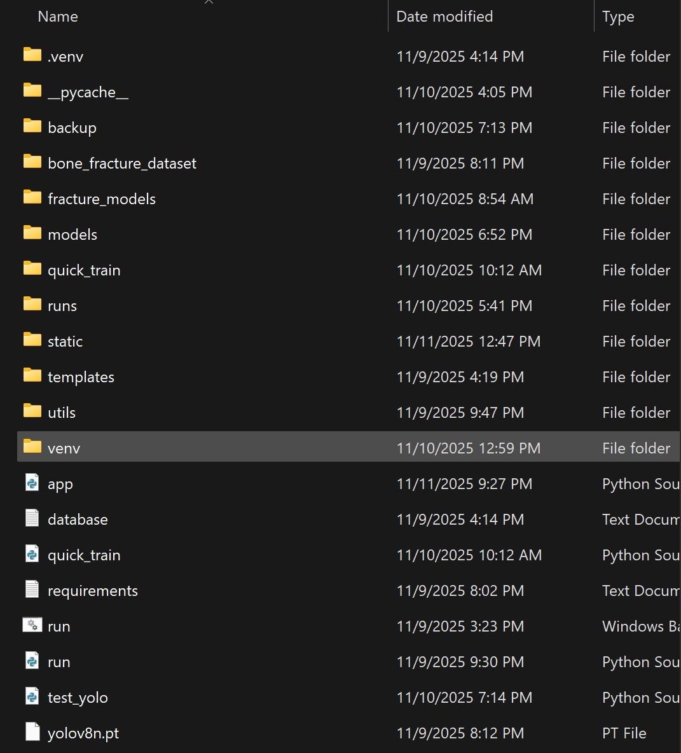
Step 2: Processing the data
This module contains the core machine learning components for automated bone fracture detection. The system utilizes YOLOv8 deep learning architecture, with model weights stored in yolov8n.pt and custom-trained fracture models maintained in the fracture_models directory. The detection engine processes X-ray images through Python scripts like test_yolo.py and run.py, which handle model inference and generate real-time predictions. The module includes comprehensive training pipelines in the quick_train folder and stores detection results in the runs/detect directory for performance analysis. Backup systems ensure model reliability, while utility functions in the utils folder support image preprocessing and result formatting, creating a complete AI workflow from image input to fracture detection output.

Slide 13
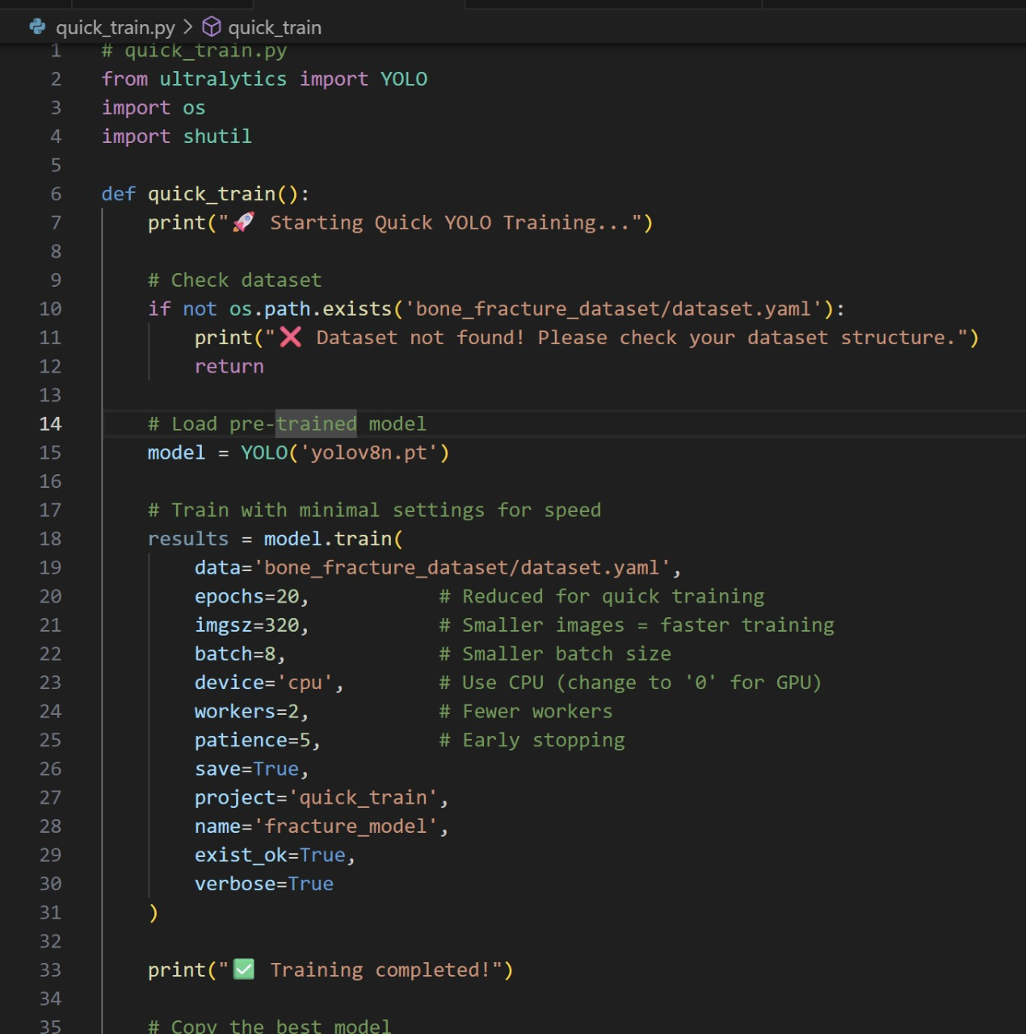
Module 2
YOLO Algorithm:
Implements YOLOv8 deep learning algorithm for real-time fracture detection
Uses convolutional neural network (CNN) architecture for image analysis
Processes entire X-ray images in single forward pass for rapid detection
Initialized with pre-trained weights from yolov8n.pt file
Fine-tuned on bone fracture dataset via quick_train.py script
Performs simultaneous localization (bounding boxes) and classification (fracture types)
Generates confidence scores for each detection
Employs transfer learning approach for medical imaging adaptation
Configurable training parameters: epochs, image size, batch optimization
Ensures high accuracy and fast processing for clinical use

Slide 14
Step 3:YOLO Algorithm
Definition:
The core of the detection system is the YOLO (You Only Look Once) algorithm, a highly efficient, single-stage Convolutional Neural Network (CNN) designed for real-time object detection. Unlike older systems that require multiple steps (like region proposal followed by classification), YOLO processes the entire X-ray image in a single forward pass. It divides the image into a grid and simultaneously predicts the bounding box coordinates and class probabilities for each grid cell. This unified architecture allows it to achieve high inference speed while maintaining high accuracy, which is critical for quick diagnostic assistance in a clinical setting. The model is initialized with pre-trained weights and then fine-tuned on the annotated X-ray dataset, adapting its feature extraction capabilities specifically for identifying subtle bone fracture patterns.
How YOLO Works in the Project:
When a patient uploads an X-ray via the web application, the image is passed to the Python backend's YOLO Fracture Detection Engine. The engine loads the fine-tuned YOLO model (yolo_fracture.pt) and performs inference on the image. In a single computational step, YOLO scans the X-ray, identifies regions containing fractures, and outputs a set of predictions. Each prediction consists of a bounding box precisely localizing the fracture, the predicted class label (e.g., 'Humerus' or 'Elbow Positive') specifying the fracture type, and a confidence score indicating the model's certainty. This output is instantly returned to the Doctor Interface, where the X-ray is displayed overlaid with the visual bounding box and classification. This visual and classified result serves as AI-powered assistance to the doctor, helping them to quickly confirm the type and severity of the injury, streamlining the process of providing a final diagnosis and prescription, with all results saved securely in the MySQL database.

Slide 15
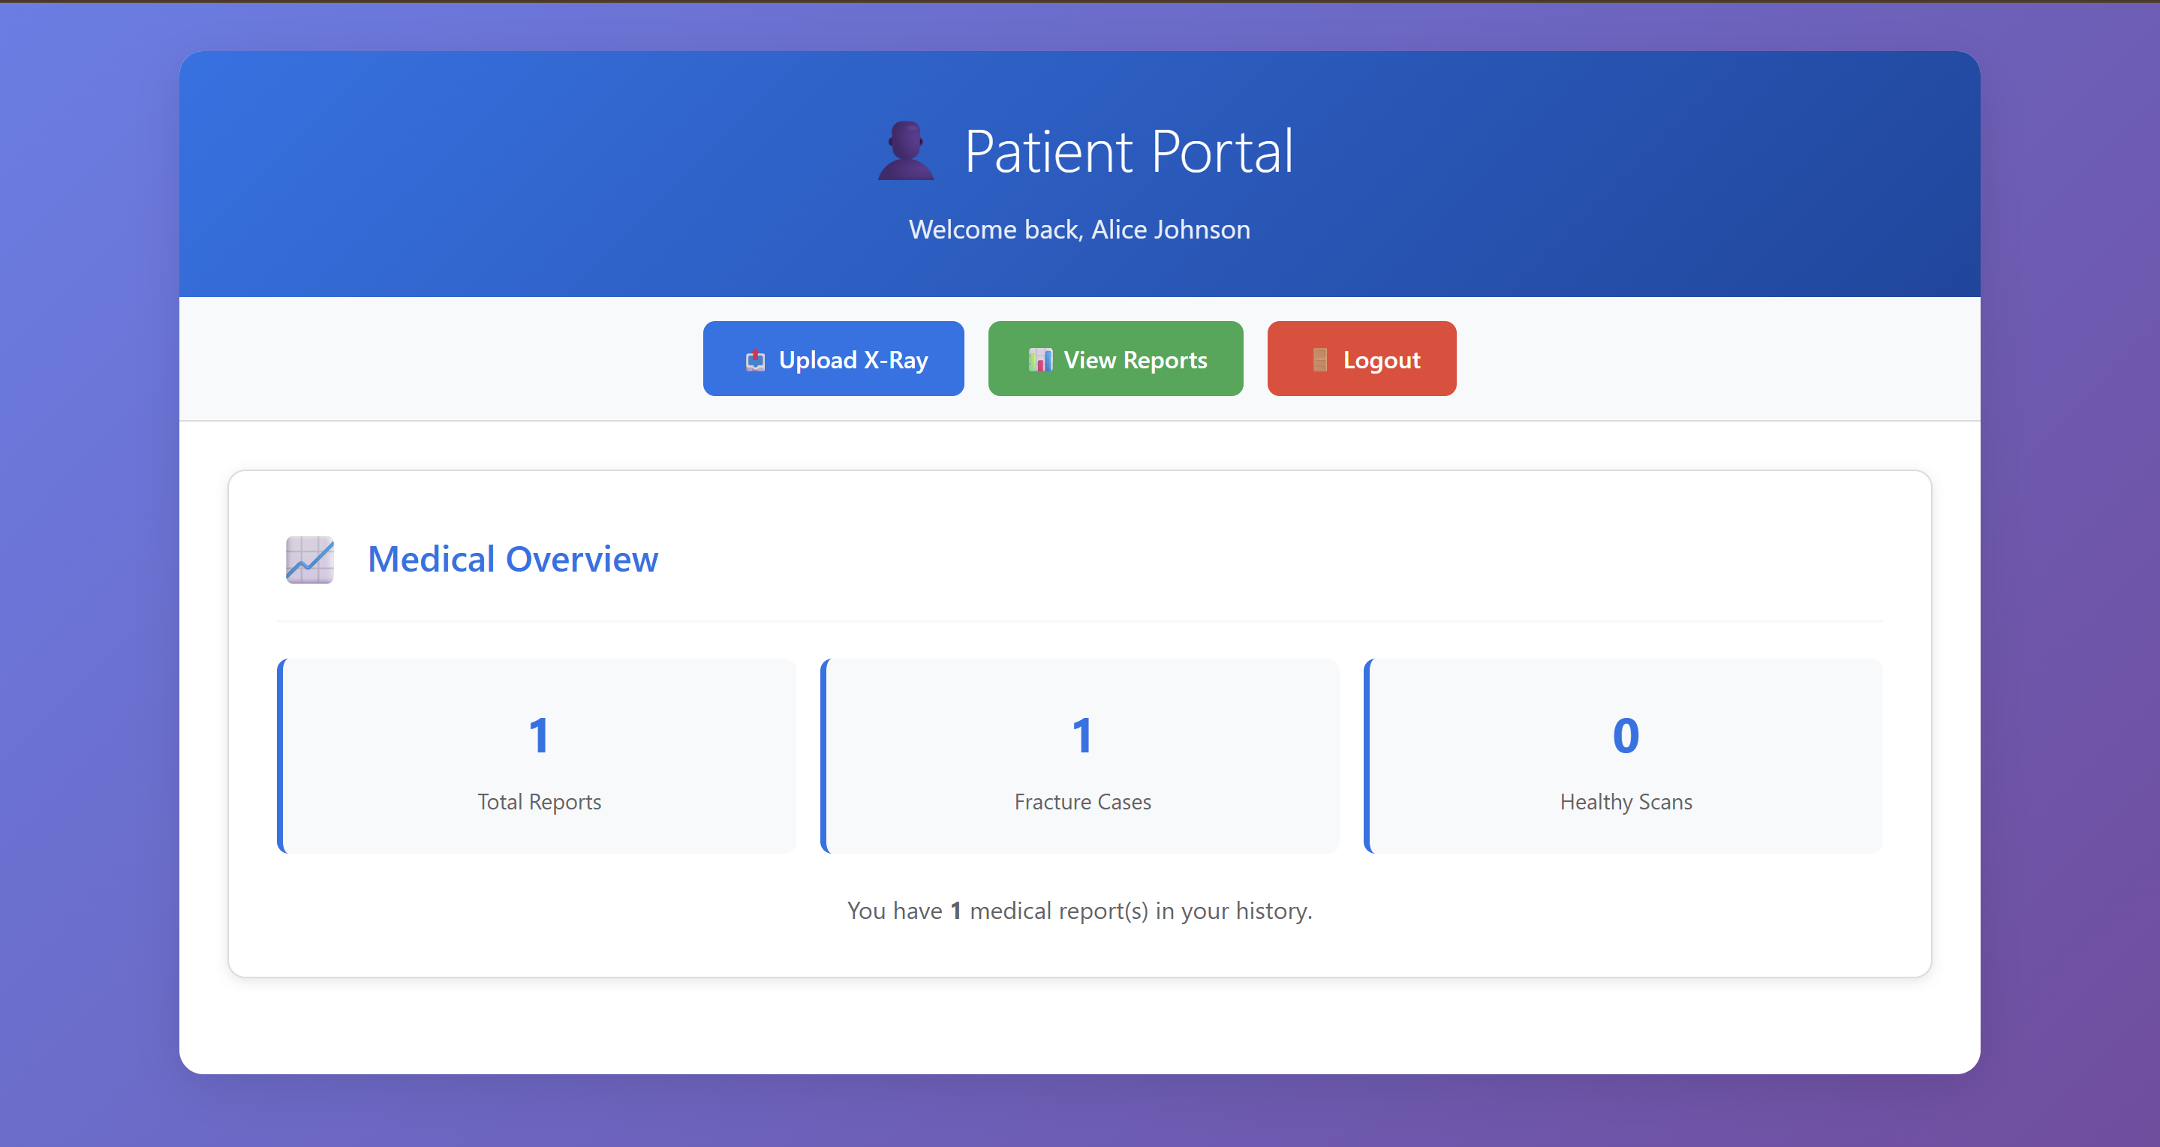
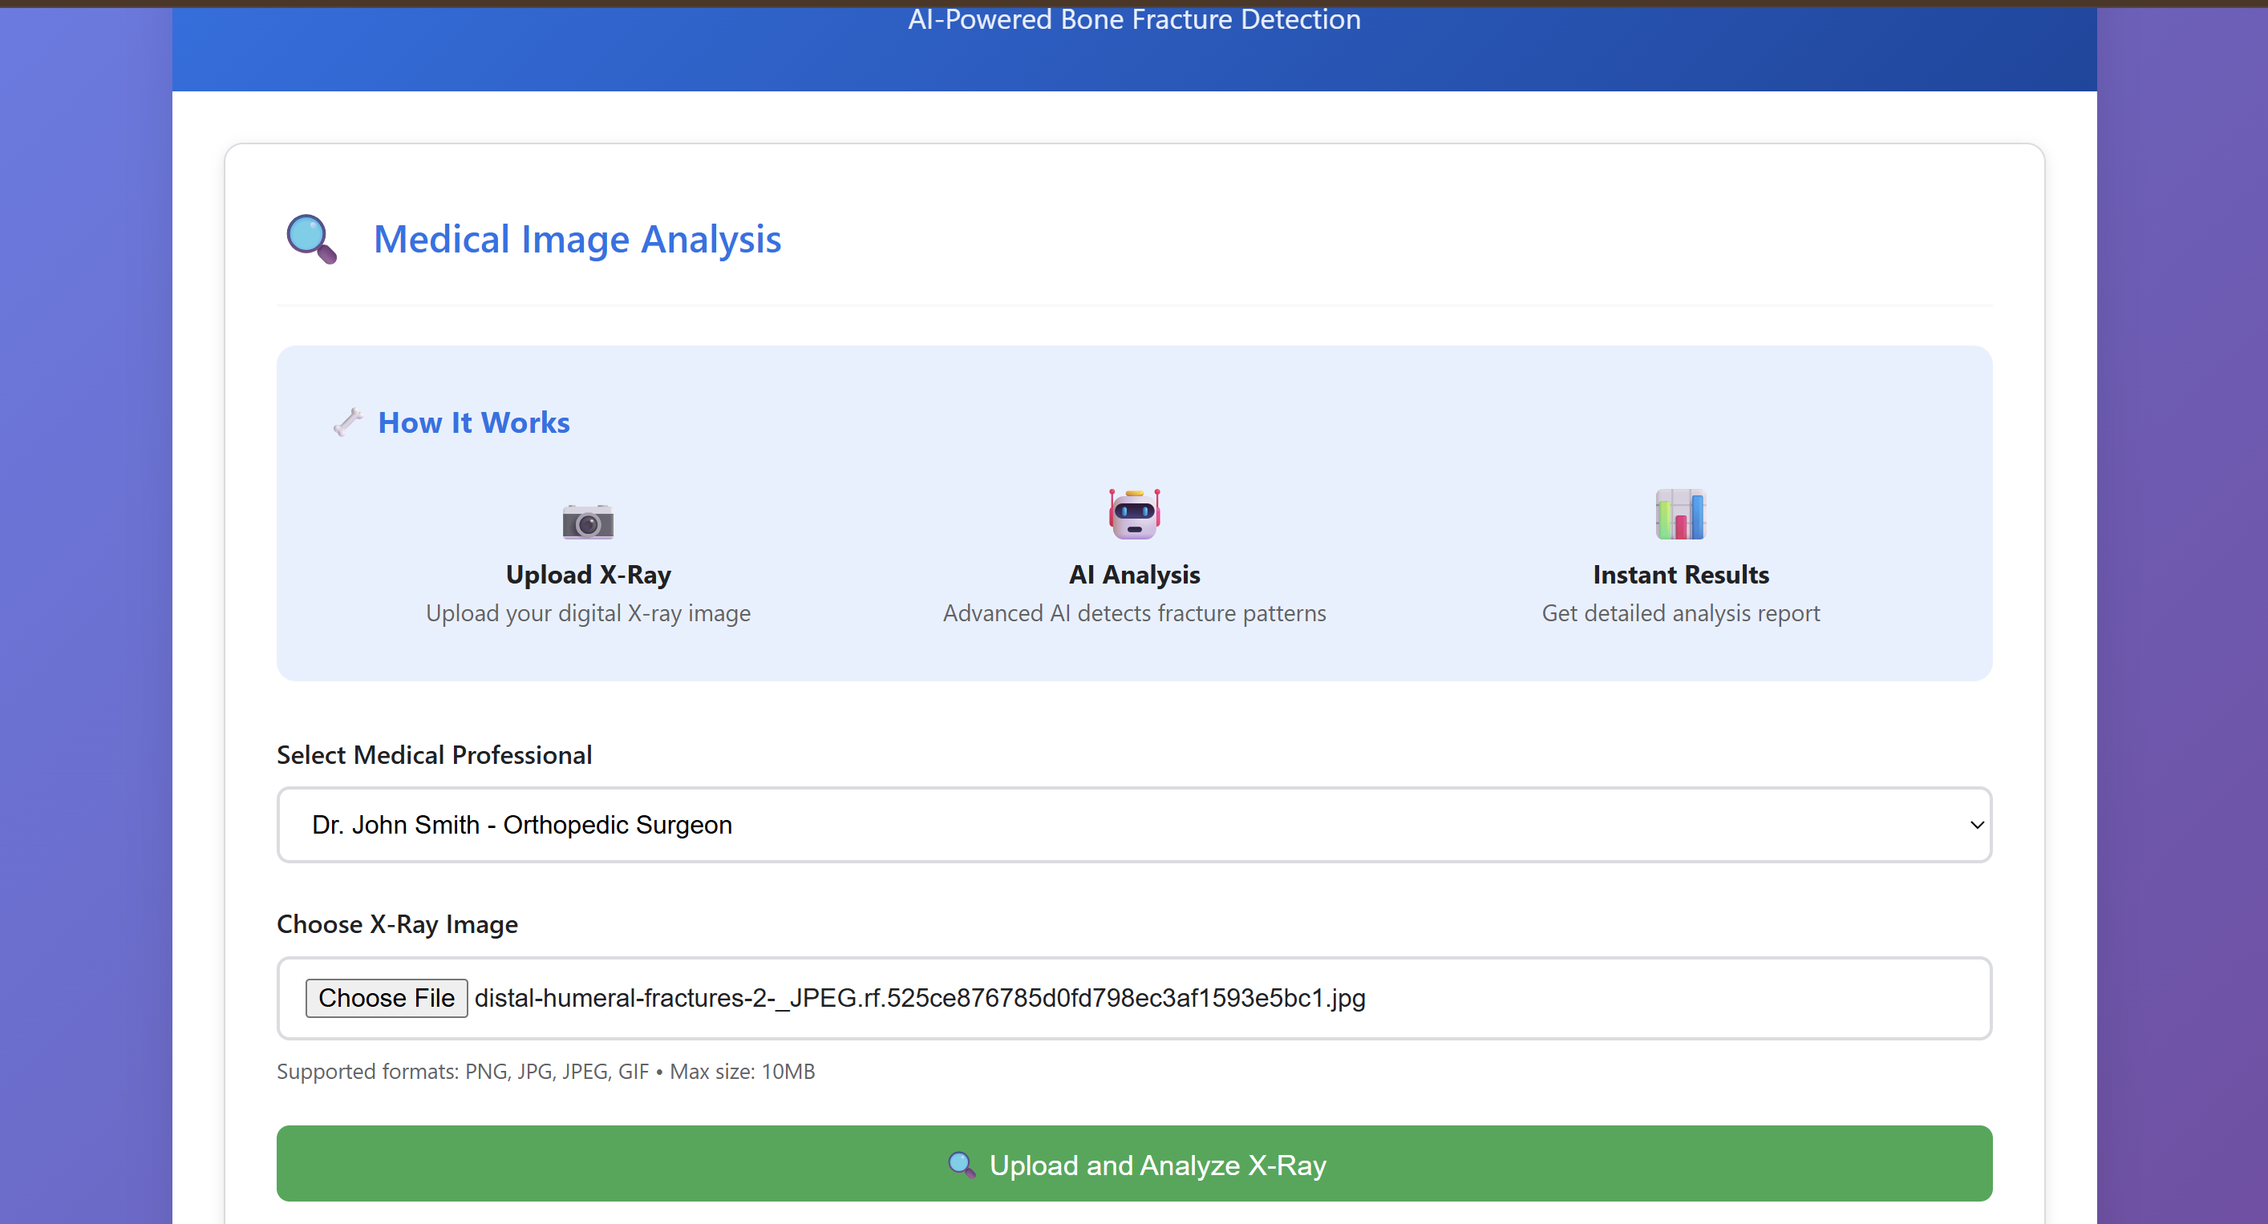
Step 4: The output

Slide 16
IMPLEMENTATION
Architecture Diagram
Data –Flow Diagram
Use Case Diagram
Class Diagram
Activity Diagram
Sequence Diagram
Collaboration Diagram(If applicable)
E-R Diagram

Slide 17
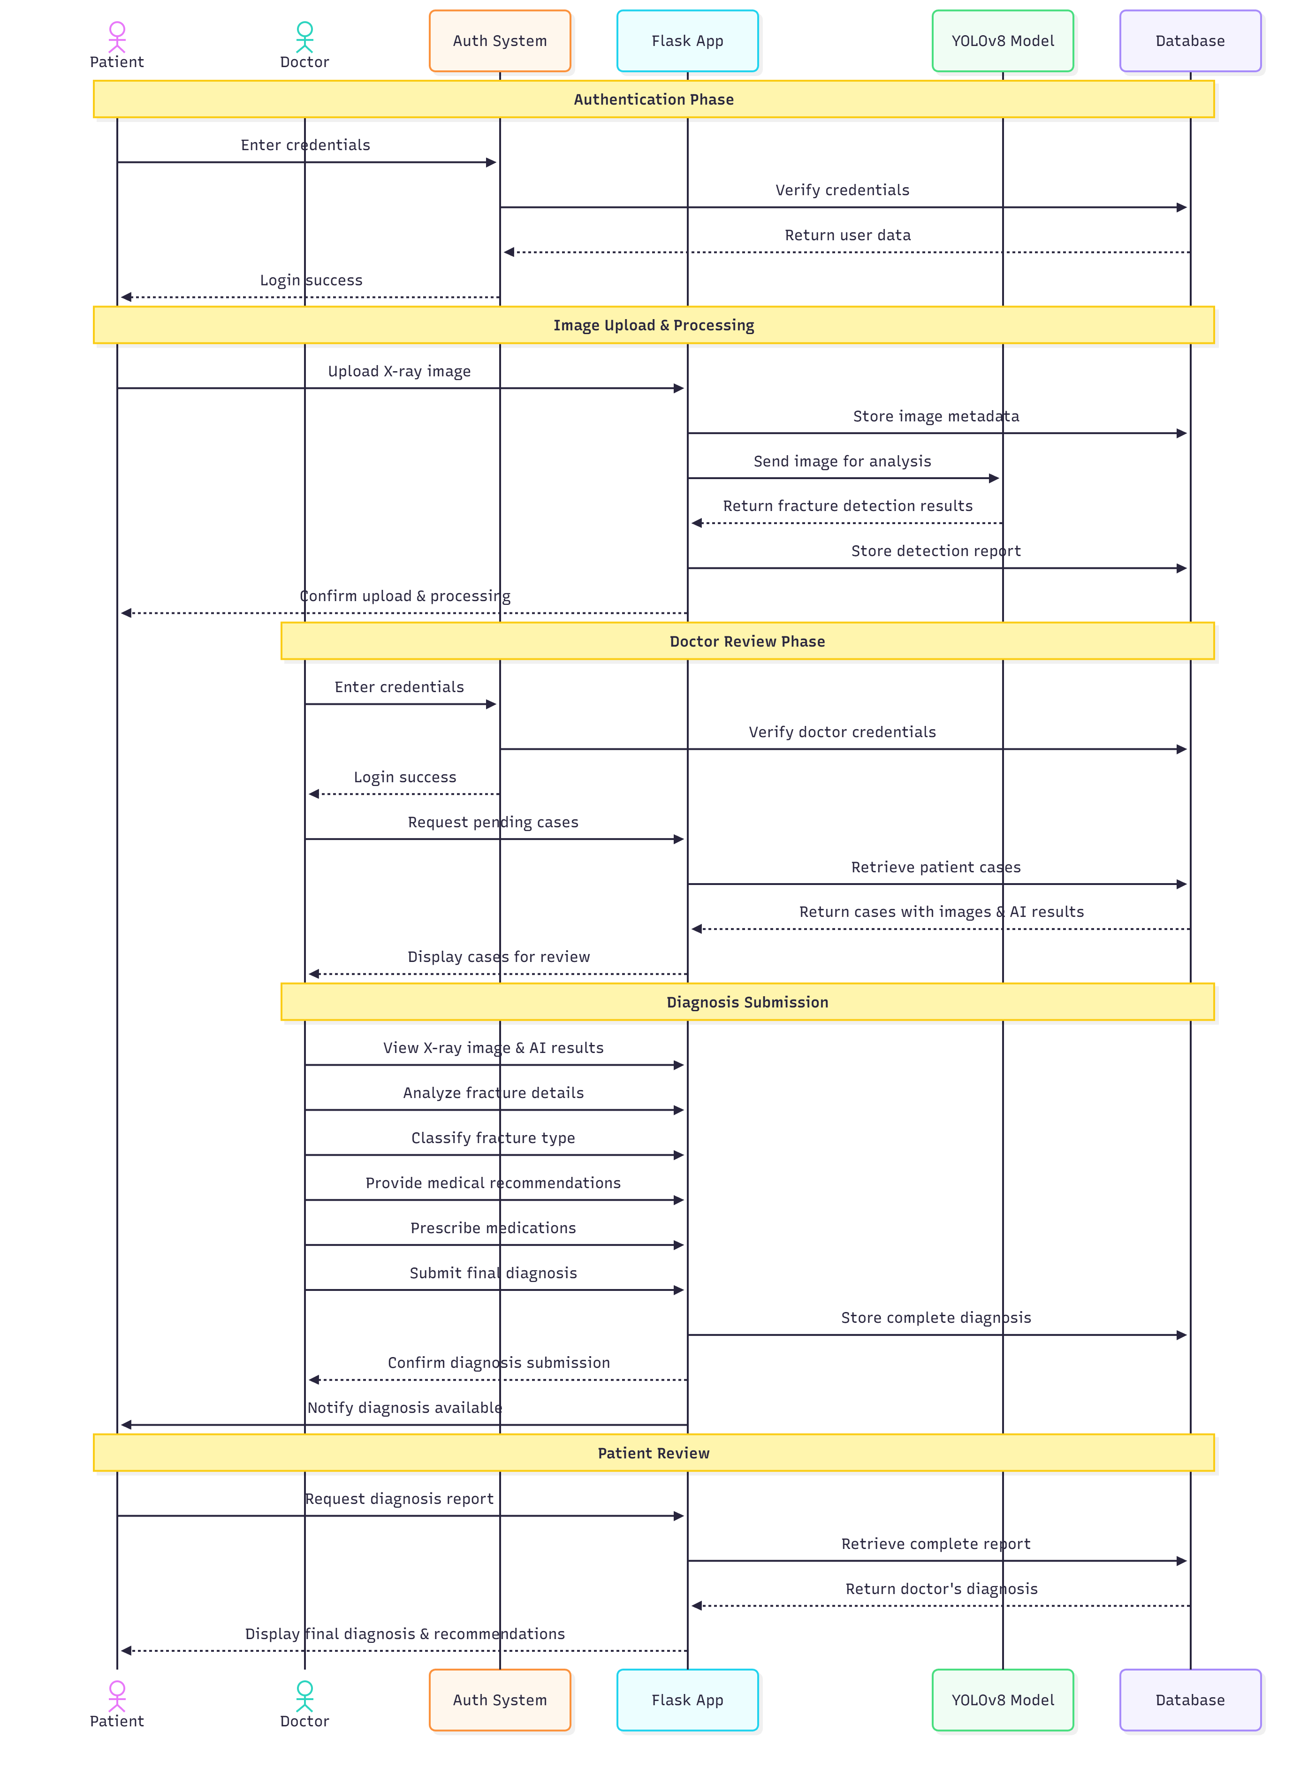
Architecture Diagram
Architecture Explanation:
The system operates in a clear sequence involving the user, the server, the AI, and the database.
Authentication: The Patient/Doctor logs in. The Flask Server (F) verifies the user's role against the Database (DB) and directs them to the correct dashboard.
AI Processing: The Patient uploads an X-ray. F saves the file and triggers the YOLO AI Module (Y). Y returns the prediction to F, which updates the DB with the AI result and sets the scan status to Pending.
Doctor Review: The Doctor accesses the scan from F. F retrieves the image and AI data from DB and renders the review page. The Doctor submits the final diagnosis, and F updates the DB accordingly.
Final Report: The Patient checks their dashboard, where F retrieves and displays the Doctor's final, authenticated report from DB.

Slide 18
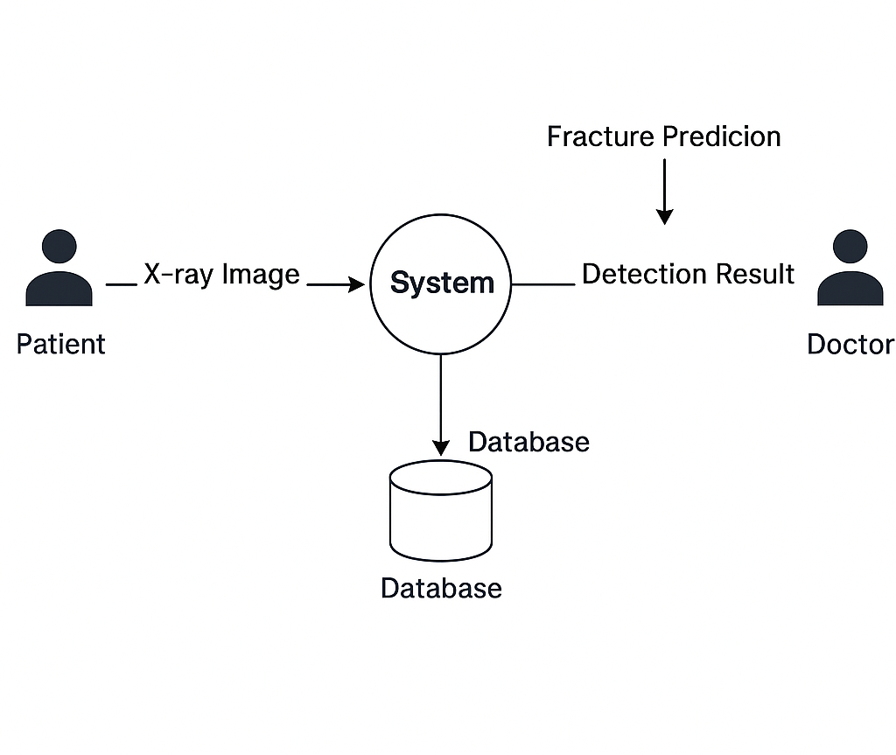
Data –Flow Diagram
The system is organized around three main data handling processes, ensuring secure movement and storage of information:
User Management (P1): Patients and Doctors provide Credentials to the server, which verifies them against the DS1 (User/Role Records) and determines access rights.
Scan Upload & AI Processing (P2): The Patient uploads the X-ray File. P2 saves the image to DS3 and records the scan details in DS2 (Scan Metadata). It then loads the YOLO Model Weights (DS4) and stores the resulting AI Prediction & Confidence back into DS2.
Doctor Review & Reporting (P3): The Doctor receives pending scans from DS2 and retrieves the X-ray from DS3. After providing the Final Diagnosis and Written Report, P3 updates the comprehensive scan record in DS2, which subsequently provides the Final Report Status to the Patient.

Slide 19
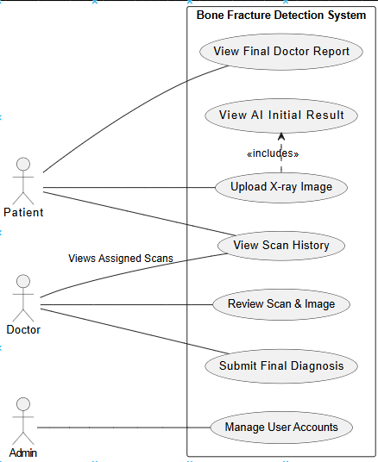
Use Case Diagram
Upload X-ray Image (U1): The Patient's main action. This is the entry point for the diagnostic workflow, directly leading to the AI analysis and the creation of a pending record.
View AI Initial Result (U2): This use case follows immediately after the image upload. It gives the Patient and the Doctor a quick, non-authoritative prediction from the YOLO model.
View Scan History (U3): This allows the Patient to track the status of all their submitted scans and enables the Doctor to see their assigned queue of cases awaiting review.
Review Scan & Image (U4): The Doctor's key task. This involves retrieving and examining the X-ray file and the corresponding metadata to prepare for the final diagnosis.
Submit Final Diagnosis (U5): The concluding action performed by the Doctor, where they write the official report and set the definitive medical status (e.g., Fracture Detected), thus finalizing the case.
View Final Doctor Report (U6): This is the ultimate goal for the Patient, allowing them to access the authenticated report and diagnosis submitted by the medical professional.
Manage User Accounts (U7): The core responsibility of the Administrator, involving creating, modifying, and deactivating accounts for other staff (like Doctors).

Slide 20
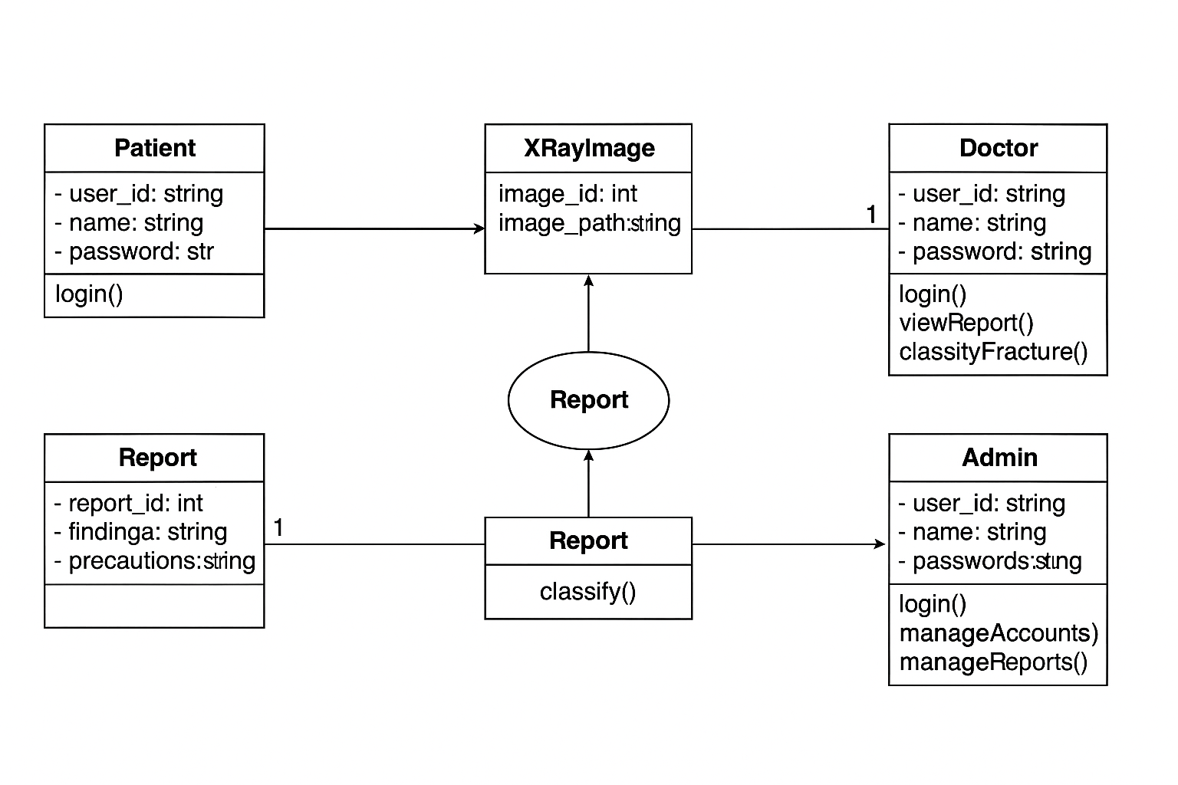
Class Diagram
The class diagram illustrates the core system architecture with three main user roles: Patient, Doctor, and Admin. Patients can upload X-ray images and access their medical reports through login functionality. Doctors possess additional capabilities to view detailed reports and classify fracture types using specialized medical expertise. Administrators manage system operations including user account management and report oversight. The XRayImage class stores medical image data, while the Report class handles fracture analysis results and classification outcomes, creating a comprehensive healthcare management system that connects patients with medical professionals through a secure digital platform.

Slide 21
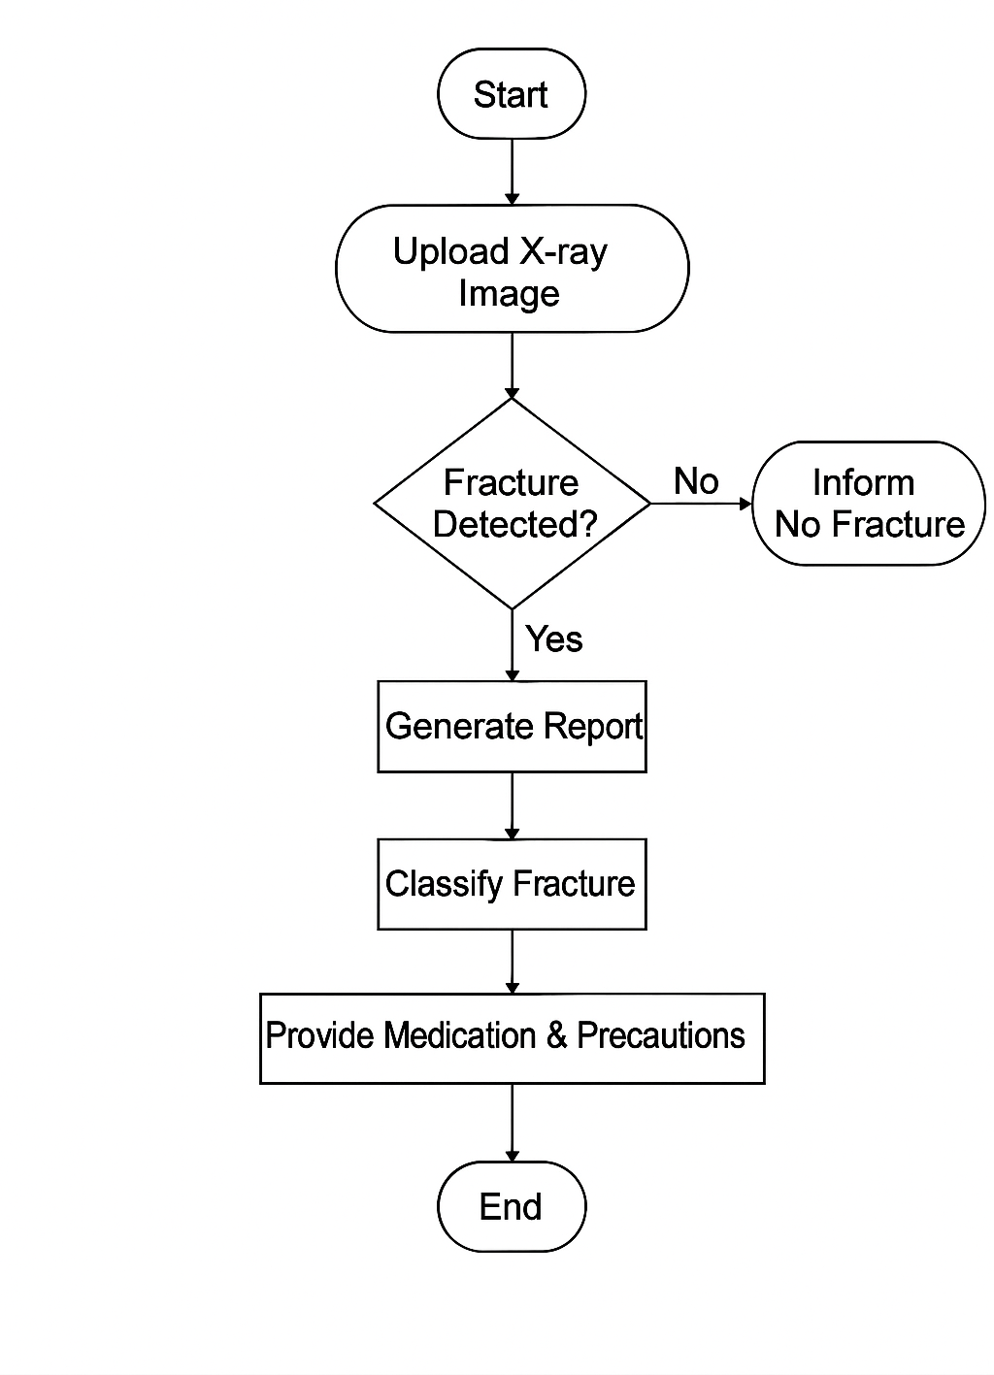
Activity Diagram
The activity diagram illustrates the complete workflow of the bone fracture detection system, beginning with the patient uploading an X-ray image for analysis. The system then performs automated fracture detection using the YOLO deep learning algorithm to identify potential bone injuries. If no fracture is detected, the system immediately informs the user that the X-ray shows no signs of fracture, providing reassurance and concluding the process. However, when a fracture is successfully identified, the system proceeds to generate a comprehensive medical report detailing the findings. This is followed by fracture classification, where the system categorizes the type and severity of the detected injury based on established medical protocols. Finally, the system provides appropriate medication recommendations and necessary precautions tailored to the specific fracture type, ensuring the patient receives complete guidance for treatment and recovery. This streamlined process ensures efficient diagnosis and timely medical intervention while maintaining clear communication with patients throughout the diagnostic journey.

Slide 22
Sequence Diagram
The Sequence Diagram details the communication timeline between the system's components, acting as the operational blueprint.
Authentication Flow: The Flask Server (F) manages the initial login request. It communicates with the DB to verify the user's Role (Patient or Doctor) and establish the session. This action ensures all subsequent requests are routed and executed with the correct permissions.
AI Control Flow: F serves as the central orchestrator after the Patient uploads the X-ray. It first saves the file and updates the DB metadata. Critically, F then explicitly calls the YOLO AI Module (Y) to run the intensive object detection prediction. Y returns the result and confidence score directly to F, enabling the automatic assignment of the scan to a Doctor.
Doctor Workflow: When the Doctor initiates a Review, F retrieves all necessary context (the image path and the AI data) from the DB. After careful examination, the Doctor submits the Final Report. F then executes the definitive write operation to the DB, securing the official diagnosis record and marking the case complete.
Reporting: The Patient is served the final report only after F retrieves the completed, fully reviewed, and authenticated data from the DB. This guarantees the patient sees the official, finalized status, concluding the entire diagnostic cycle.

Slide 23
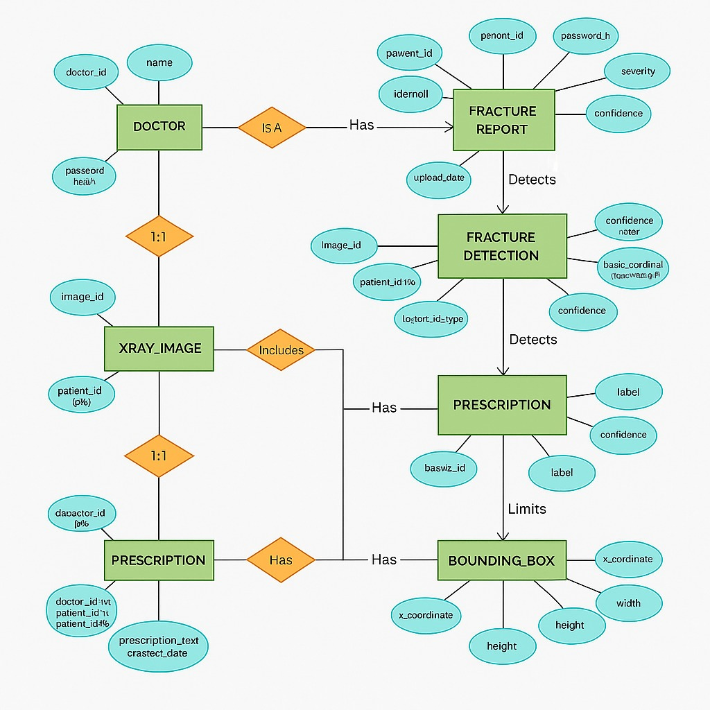
E-R Diagram
Entity-Relationship (ER) Diagram Explanation
The ER diagram illustrates how medical data flows from X-ray upload to diagnosis and treatment.
It defines entities like Doctor, Patient, Fracture Report, Detection, and Prescription with clear relationships.
Each Fracture Report is linked to one image and can have multiple detections and bounding boxes.
The design supports secure data handling, ensuring doctors can analyze and update patient records efficiently.
Overall, it provides an organized structure for automated fracture detection and medical record management

Slide 24
TESTING
  UNIT TESTING
  INTEGRATION TESTING
  FUNCTIONAL TESTING
  WHITE BOX TESTING
  BLACK BOX TESTING

Slide 25
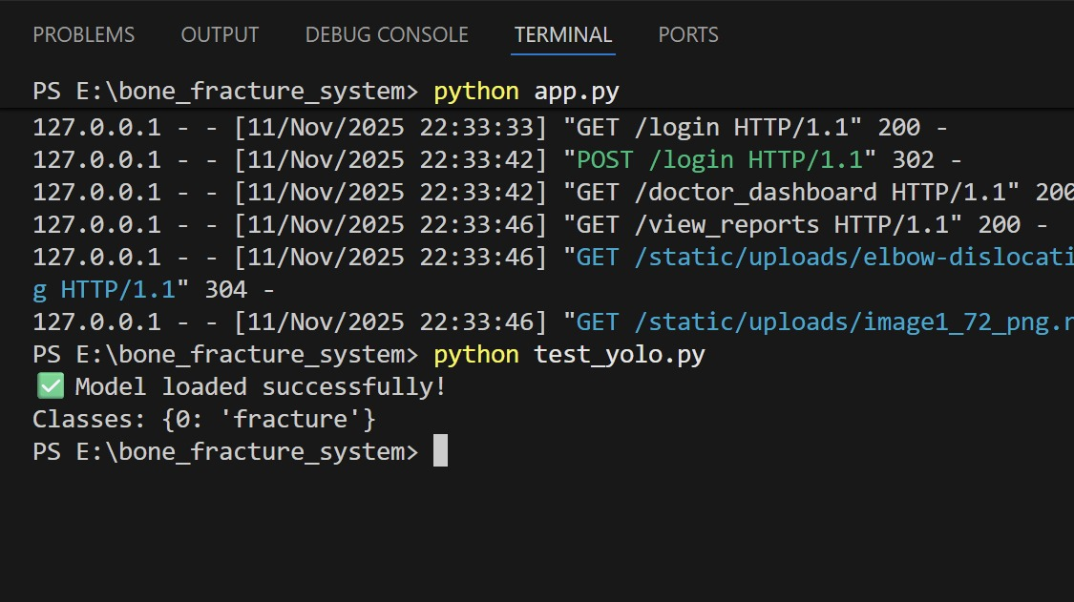
  UNIT TESTING
Unit testing involves testing individual components of the software program or application. The main purpose behind this is to check that all the individual parts are working as intended. A unit is known as the smallest possible component of software that can be tested.

Slide 26
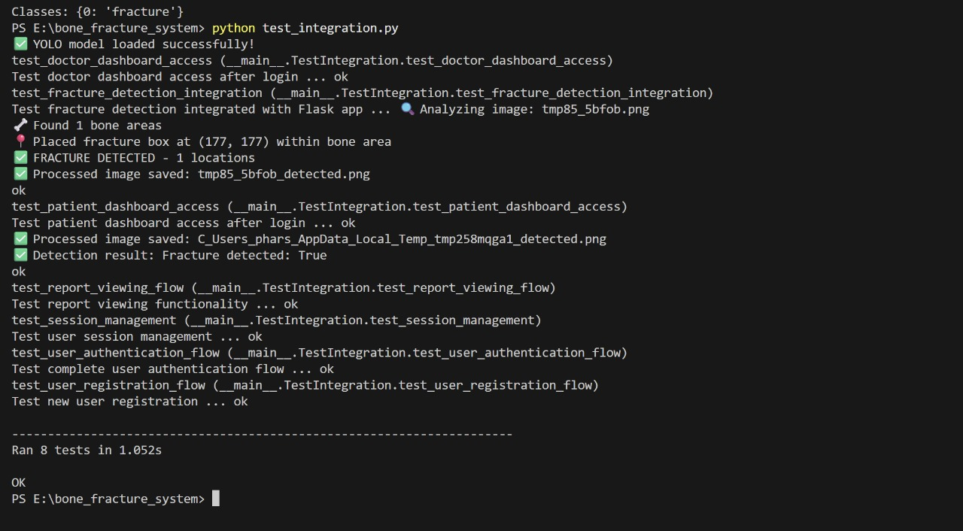
  INTEGRATION TESTING
Software components are gradually merged and then tested as a cohesive group in an approach known as integration testing.

Slide 27
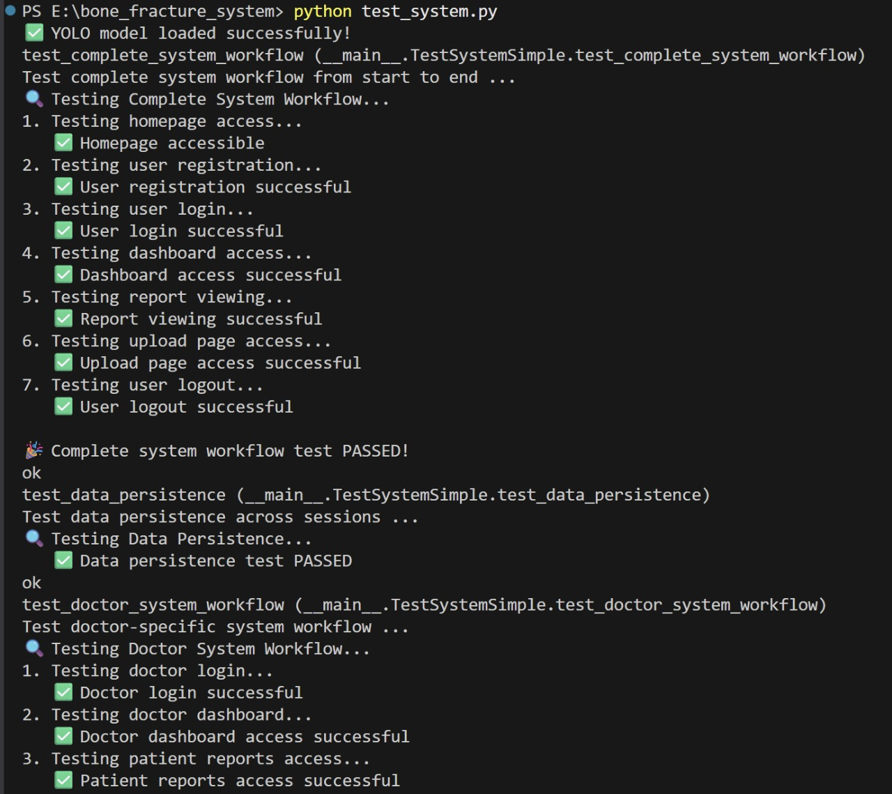
SYSTEM TESTING
Testing an entire, fully integrated software product is known as system testing

Slide 28
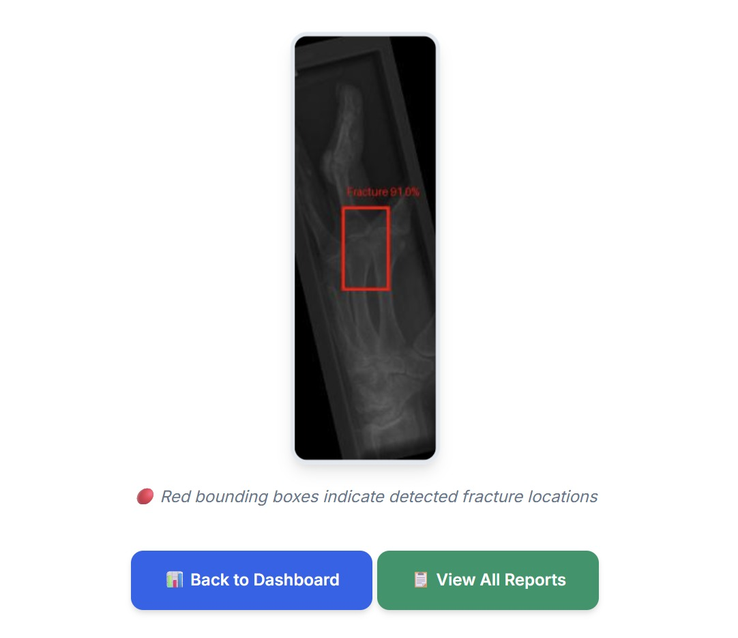
FUNCTIONAL TESTNG
One sort of testing called functional testing looks to determine if every component of the programme functions in accordance with the requirements of the software.

Slide 29
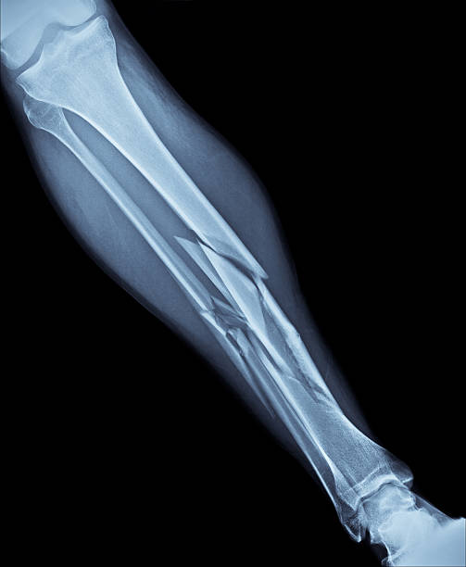
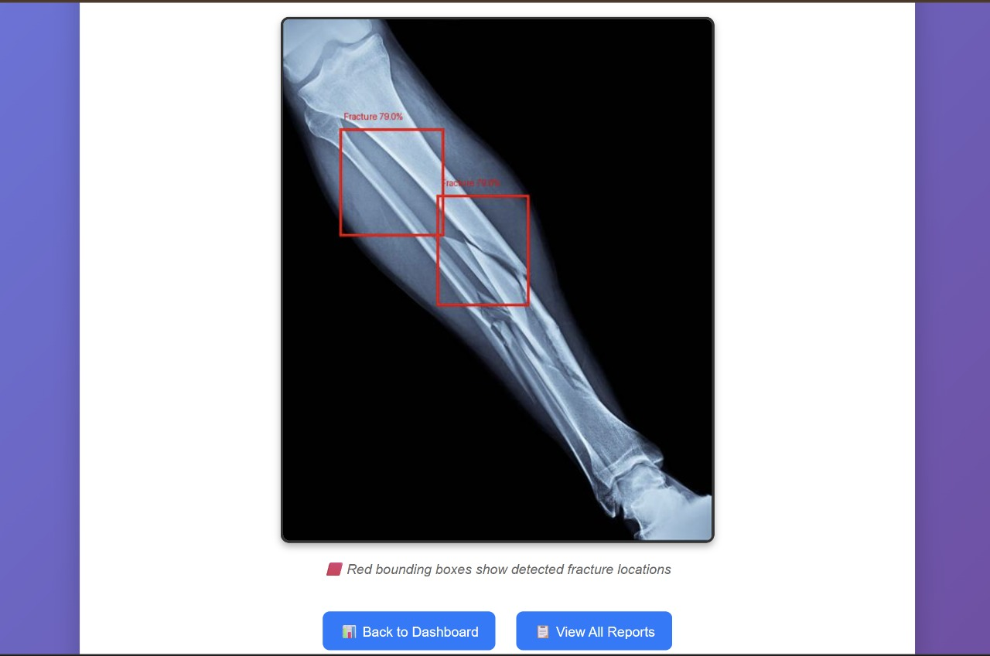
INPUT AND OUTPUT
INPUT:
OUTPUT:

Slide 30
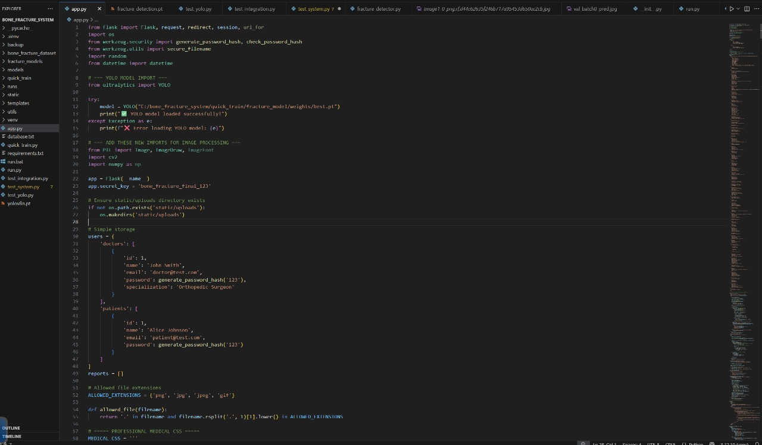
SOURCE CODE

Slide 31
OUTPUT

Slide 32
CONCLUSION
Full System Integration: The project successfully linked the Flask web application, Flask-SQLAlchemy (database), and the YOLO Deep Learning model into one cohesive, functional diagnostic pipeline.
Role-Based Security: Implemented mandatory authentication and distinct workflows for Patients, Doctors, and Administrators, ensuring secure access and proper handling of medical data.
Rapid AI Triage: The system provides immediate AI Prediction and Confidence Scores upon image upload, significantly accelerating the initial diagnosis time for the doctor.
Traceability & Accountability: The database structure ensures every Scan record is permanently linked to the submitting patient and the official reviewing doctor, creating a complete and auditable history.
Doctor Workflow Optimization: The platform efficiently routes and queues pending scans for the Doctor, simplifying case management and final diagnosis submission.
Future Goal: AI Explainability: Next steps include integrating visualization tools (like heatmaps) to show the Doctor the exact region the AI detected the fracture, enhancing trust and clinical relevance.
Future Goal: Scalability & Alerts: Development efforts should focus on implementing asynchronous processing for handling heavy workloads and adding automated notification alerts for rapid communication between all users.

Slide 33
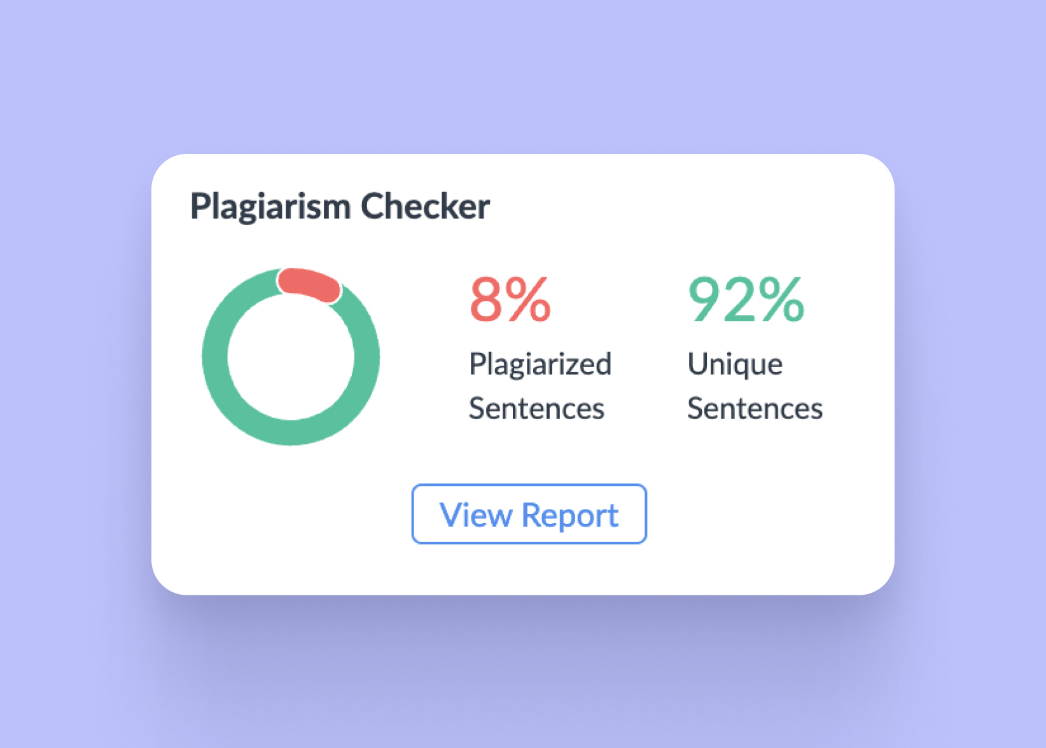
Plagiarism Report of PPT

Slide 34
Web references/video links
“Bone fracture detection using YOLO algorithm”
https://github.com/topics/yolo-bone-fracture-detection
“Automated bone fracture detection and classification using deep learning”
https://www.sciencedirect.com/science/article/pii/S1877050921003812
“YOLO based fracture detection tutorial | X-ray dataset”
https://www.youtube.com/watch?v=CyZw4bRJpcg
“Real-time object detection with YOLO for medical imaging”
      https://www.mathworks.com/help/vision/ug/object-detection-using-yolo-v2.html

Slide 35
REFERENCES
[1] A. Kutbi, A. Al-Saggaf, and A. M. Al-Ahmadi, “Artificial intelligence-based applications for bone fracture detection: A systematic review,” Healthcare, vol. 12, no. 3, pp. 309–325, 2024.
(Survey of existing fracture detection methods – shows gaps in current solutions.)
[2] L. Su, Y. Wang, and H. Chen, “Skeletal fracture detection with deep learning: A comprehensive review,” Frontiers in Radiology, vol. 2, pp. 112–128, 2023.
(Covers existing deep learning approaches and their challenges.)
[3] P. Rajpurkar et al., “MURA: Large dataset for abnormality detection in musculoskeletal radiographs,” arXiv preprint arXiv:1712.06957, 2017.
(Important dataset used for many existing fracture detection systems.)
[4] X. Ju et al., “Fracture detection in pediatric wrist trauma X-ray images using YOLOv8,” Scientific Reports, vol. 13, no. 12567, pp. 1–12, 2023.
(Supports your approach – shows YOLO is effective for fracture detection.)
[5] Z. Wu et al., “YOLOv9: Improved real-time object detection with enhanced feature learning,” arXiv preprint arXiv:2402.13616, 2024.
(Latest YOLO variant – supports your use of YOLO-based methods.)

Slide 36
THANK YOU

